Slide 1
Forecasting and Analysis of Renewable Energy
Experiential Learning Assignment : Applied Statistical Methods 2019-20 MATH F432
SUBMITTED BY : Group 12 (Nightingale Group)
Akshit Khanna 2017A7PS0023P
Jhaveri Ayush Rajesh 2017A7PS0215P
Vitthal Bhandari 2017A7PS0136P
Shivankur Sharma 2017B4A71013P
Jyoti Ranjan Pagoda 2017B4PS0506P
Mohit Kulhari 2017B4TS1206P
Nishchay Pareek 2017B4TS1204P

Slide 2
Objectives
To understand about various renewable energy resources
To analyze solar and wind energy for Charanka Solar Park (Gujarat) using 2000-2010 hourly data.
To differentiate between various terms such as DHI, DNI, GHI, temperature etc. based upon their relevance to solar energy and/or wind energy
To understand the data and correlations among its variables
To identify the underlying probability distributions of GHI and wind speed for the year 2000
To visualize/identify any trend/seasonality in the time series for wind speed data from 2000-2010 and to forecast the wind speed for Jan 2011.

Slide 3
Renewable energy
Renewable energy is energy produced from sources that do not deplete or can be replenished within a human’s life time. The most common examples include wind, solar, geothermal, biomass, and hydropower.
The Indian Government has increased the target of renewable energy capacity to 175 GW by the year 2022 which includes 100 GW from solar, 60 GW from wind, 10 GW from bio-power and 5 GW from small hydro-power.
Wind power accounts for 10% of India's total installed power capacity.

Slide 4
Descriptive Analysis
Direct Normal Irradiance (DNI): is equal to the extra-terrestrial irradiance above the atmosphere minus the atmospheric losses due to absorption and scattering.
Diffuse Horizontal Irradiance (DHI): or Diffuse Sky Radiation is the radiation at the Earth's surface from light scattered by the atmosphere.
Global Horizontal Irradiance (GHI): is the total irradiance from the sun on a horizontal surface on Earth.
GHI = DNI * cos(θ) + DHI
Global Normal Irradiance: (GNI) is the total irradiance from the sun at the surface of Earth at a given location with a surface element perpendicular to the Sun.
These are all the terms relating to SOLAR ENERGY

Slide 5
Descriptive statistics
Table II : Correlation Coefficients with Wind Speed and GHI
The statistics we used are correlation coefficients of all variables with both wind energy and solar energy.
wind speed :- DNI, DEW POINT, PRESSURE, RELATIVE HUMIDITY, PRECIPITABLE WATER, account for about 70% of the total variance.
GHI :- DHI,DNI,CLEAR-SKY DHI,CLEAR-SKY DNI, RELATIVE HUMIDITY,SOLAR-ZENITH ANGLE,TEMPERATURE, account for about 85% of the total variance
Variables | WIND SPEED | GLOBAL HORIZONTAL IRRADIANCE(GHI)
1.DHI | -0.1227 | 0.91594
2.CL-DHI | -0.1177 | 0.93369
3.CL-DNI | -0.1943 | 0.9414
4.Dew point | 0.2468 | NA
5.Pressure | -0.4152 | 0.04501
6.Relative humidity | 0.218 | -0.3235
7.Precipitable water | -0.2615 | NA
8.Solar zenith angle | 0.1433 | -0.8579
9.Snow depth | NaN | NA
10.DNI | -0.2862 | 0.93369
11.Temperature | 0.0203 | 0.6628
Table I : Correlation Coefficients with Wind Speed and GHI

Slide 6
GHI and Wind-Speed Analysis
In order to test whether these datasets follows our specific distributions or not , we will take help from SPC software of excel which provides p-p plot and AIC values.
P-P(Probability-Probability) plot : it plots the empirical cumulative distribution function(CDF) values (based on the data) against the theoretical CDF values (based on the specific distribution). If the P-P plot is close to a straight line, then the specific distribution fits the data.
AIC(Akaike Information Criterion) : The main objective of AIC is to provide a means for model selection. AIC estimates the quality of each model, relative to each of the other models. Given a set of candidate models for the data, the preferred model is the one with the minimum AIC value. Thus AIC rewards goodness of fit(as assessed by the likelihood function).

Slide 7
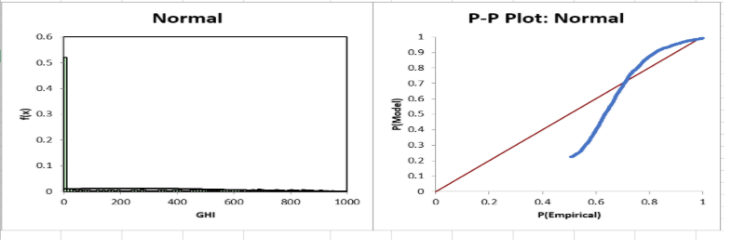

GHI Data Analysis
From the plot, it is clear that our data for GHI dataset does not follow normal probability distribution, as the P-P plot clearly indicates that the cumulative distribution function of GHI dataset is not matching with the theoretical CDF of the normal distribution.
Fig 1: P-P plot of GHI dataset
S.NO | PROBABILITY DISTRIBUTION | AIC VALUE
1 | logNormal-Three Parameter | 62718
2 | log Logistic - Three Parameter | 64030
3 | Exponential-Two Parameter | 113040
4 | Normal | 125298
Since the AIC value of logNormal distribution(62718) is minimum from all other distributions. Hence we can conclude that the data for GHI dataset comes from logNormal probability distribution.
Table II: AIC values for possible distribution models for GIC dataset

Slide 8
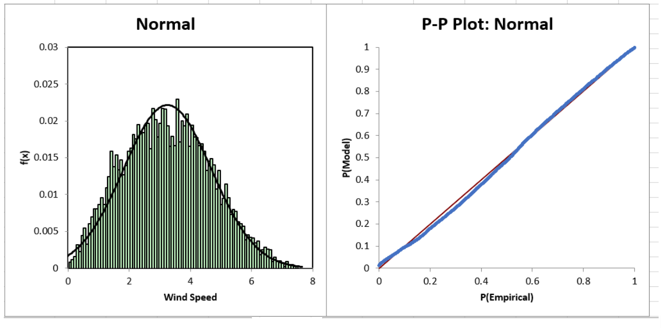
Wind Speed Data Analysis
we can initially assume that our dataset follows Normal distribution but we can check for other distributions
Fig 3: P-P plot for Normal distribution and wind speed dataset
S.NO. | PROBABILITY DISTRIBUTION | AIC VALUE
1 | Weibull-Three Parameter | 30956
2 | Weibull | 31010
3 | Gamma-Three Parameter | 31156
4 | logNormal - Three Parameter | 31229
5 | Normal | 31725
Since the AIC values of all other distributions are very similar to Normal distribution, we can conclude that the data for Wind-Speed dataset comes from a normal distribution
Table III: AIC values for possible distributions for wind speed dataset

Slide 9
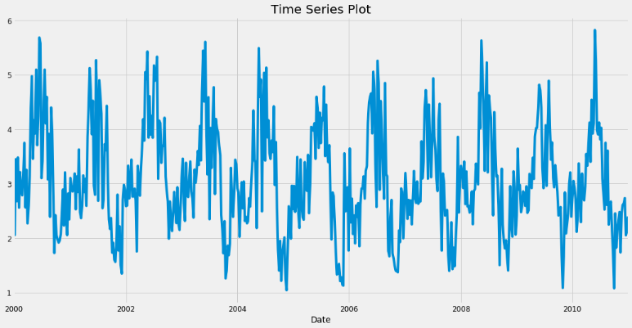
Time Series Decomposition of Wind-Speed Data
Fig 4 : Time series plot of wind-speed data
It can be inferred that there is seasonality present with a horizontal trend. But in order to validate this inference, the time series needs to be decomposed into various components using the statsmodels library of python

Slide 10
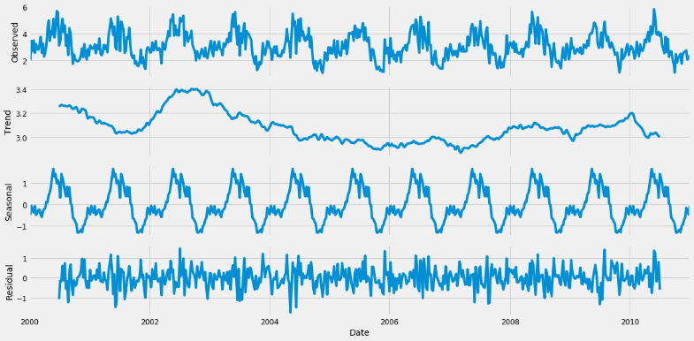
Fig 5 : Additive time series decomposition of wind-speed data
Observing from the time series decomposition in Fig 5, the trend does not show any pattern, there is a clear pattern in the seasonal component and the residual component is random. Thus, it can be concluded that there is no trend in the data (horizontal trend) and there exists seasonality over an annual period.

Slide 11
Forecasting of Wind-Speed Data
The dataset used for forecasting is resampled to weekly frequency for reduced computation costs in forecasting models. The weekly dataset has a yearly seasonal period as concluded from the decomposition used above.
ARIMA Forecasting : Auto Regressive Integrated Moving Average (ARIMA) is a class of models that explains a given time series based on its own past values and the lagged forecast errors, so that equation can be used to forecast future values. Any non-seasonal time series that exhibits patterns and is not a random white noise can be modelled with ARIMA models.
SARIMA Forecasting : If a time series, has seasonal patterns, then you need to add seasonal terms to the ARIMA model and it becomes SARIMA, short for ‘Seasonal ARIMA’.

Slide 12
Forecasting Used
Since our data has prominent seasonal component and apart from it the time series is stationary, therefore we use SARIMA model to forecast Wind-Speed data.
Assumptions for SARIMA -
There must be a consistent seasonal variation.
The time series involved must be weakly stationary or can be integrated to form a stationary series apart from the seasonal component.
The error terms are assumed to be independent and identically distributed variables sampled from a normal distribution with zero mean.
The weekly dataset has 52 periods in a season as a season consists of a single year. The data used for training is from 2000 to 2010 Wind-Speed data.

Slide 13
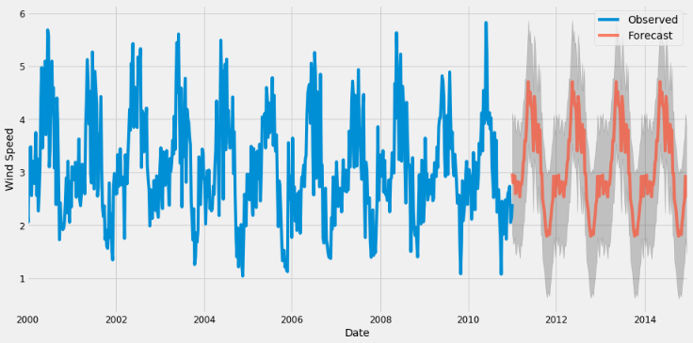
Fig 6: Forecast of SARIMA model for years 2011-14

Slide 14
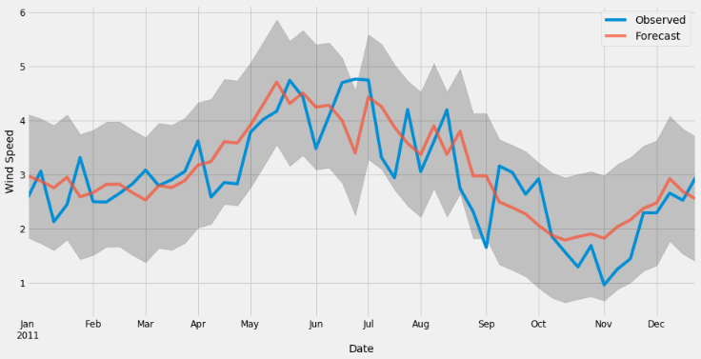
Fig 7: Comparison of the forecast and actual data of 2011 with confidence intervals

Slide 15
Results
Root Mean Square Error (RMSE) | 0.59
Mean Absolute Error (MAE) | 0.49
Mean Absolute Percentage Error (MAPE) | 19.53
Table IV : Forecast Evaluation Metrics
With a Mean Absolute Percentage Error of 19.53%, we can conclude that the SARIMA forecasting model has a reasonable performance.

Slide 16
Conclusions from our Study
Renewable sources are an important source of energy to us because non-renewable sources could deplete in future.
Correlation coefficients of variables with wind speed and GHI indicate that DNI, dew point, pressure, relative humidity, precipitable water affect wind speed while DHI, DNI, clear-sky DHI, clear-sky DNI, relative humidity, solar-zenith angle, temperature affect GHI.
Wind speed follows a Normal distribution while GHI follows a logNormal distribution.
The time series data of wind speed has a seasonal component but no trend.
SARIMA forecasting is an effective method for forecasting wind speed data.

Slide 17
List of References
Forecasting:
https://towardsdatascience.com/an-end-to-end-project-on-time-series-analysis-and-forecasting-with-python-4835e6bf050b
Renewable Energy:
https://www.indiary.org/en/legal-advice/Renewable-Energy-in-India-Current-Status-and-Future-Potential-2-79-429
AIC:
https://www.statisticshowto.datasciencecentral.com/akaikes-information-criterion/
GHI:
https://www.3tier.com/en/support/solar-prospecting-tools/what-global-horizontal-irradiance-solar-prospecting/

Slide 18
THANK YOU

